Slide 1
USES OF CALCULUS IN DAILY LIFE

Slide 2
Group member
Junaid ul Hassan
Ahad ali Zafar
Hamza mehmoo
Anique khadiM
Saad rehman raja
Jibran naeem

Slide 3
Presented by ahad ali khan

Slide 4

the most asked questions
“When am I ever going to use this in real life”

Slide 5
What is calculus
British Scientist Sir Isaac Newton (1642-1727) invented this new field of mathematics
‘Calculus’ is a Latin word, which means ‘stone.’
It can be defined as the mathematical study of change

Slide 6
Types of calculus
Two methods of calculus, differentiation and integration, are particularly useful in the practice of engineering, and are generally used for optimization and summation, respectively.

Slide 7
Uses of calculus
Engineering
Graphic designing
Physics
Medical
Architecture
chemistry

Slide 8

Presented by Junaid ul hassan

Slide 9
USES OF CALCULUS IN ENGINEERING

Slide 10
Presented by saad rehman

Slide 11
USES OF calculus in artichitecture
Architects also use integral calculus to calculate the amount of materials needed for construction and the type of support systems required to prevent constructions from collapsing.

Slide 12
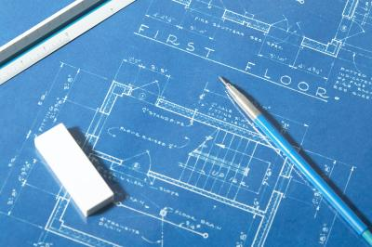

Slide 13
Presented by hamza mehmood

Slide 14
USES OF graphic designing
How is Calculus Used in Graphic Design?
A graphics artist uses calculus to determine how different three-dimensional models will behave when subjected to rapidly changing conditions. This can create a realistic environment for movies or video games.

Slide 15


Slide 16
USES OF graphic designing
Like in some of your favorite childhood movies, calculus is used to calculate the shapes and functions needed to create the right response from the variable and make it seem as real as possible.

Slide 17
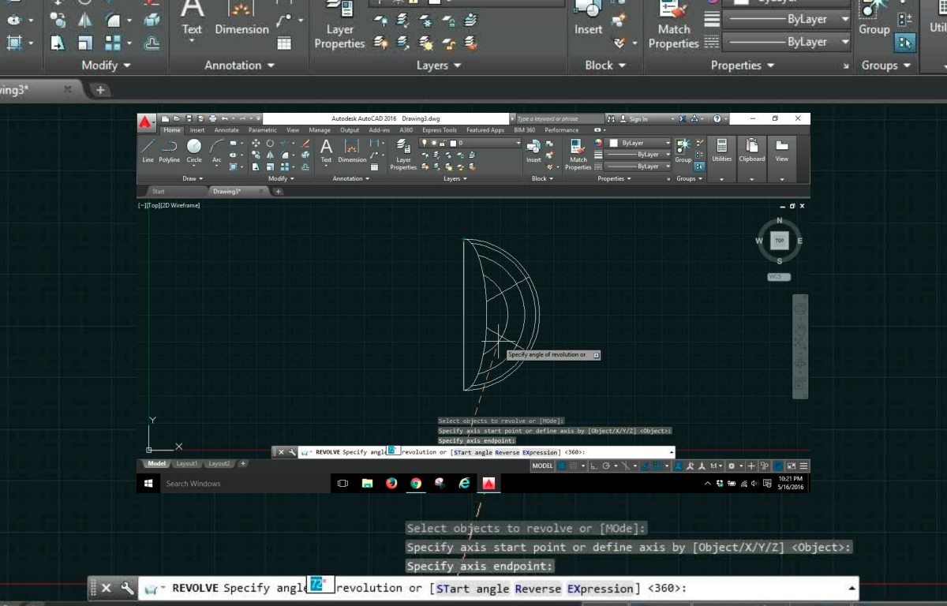

Slide 18
USES OF graphic designing
But, How Do They Do This?
There are lots of computer software's and programs, such as the physics engine I mentioned before, available to create this animated environments. The software I'm going to focus on today is AutoCAD.

Slide 19
uses of calculus in
The best way
Hi all,
“Let us meet tomorrow at 11 am at Conference room 3 to discuss the product launch event. We will have to decide the keynote speakers and complete the event invite draft tomorrow. Please be there on time”

Slide 20
Presented by jibran naeem

Slide 21
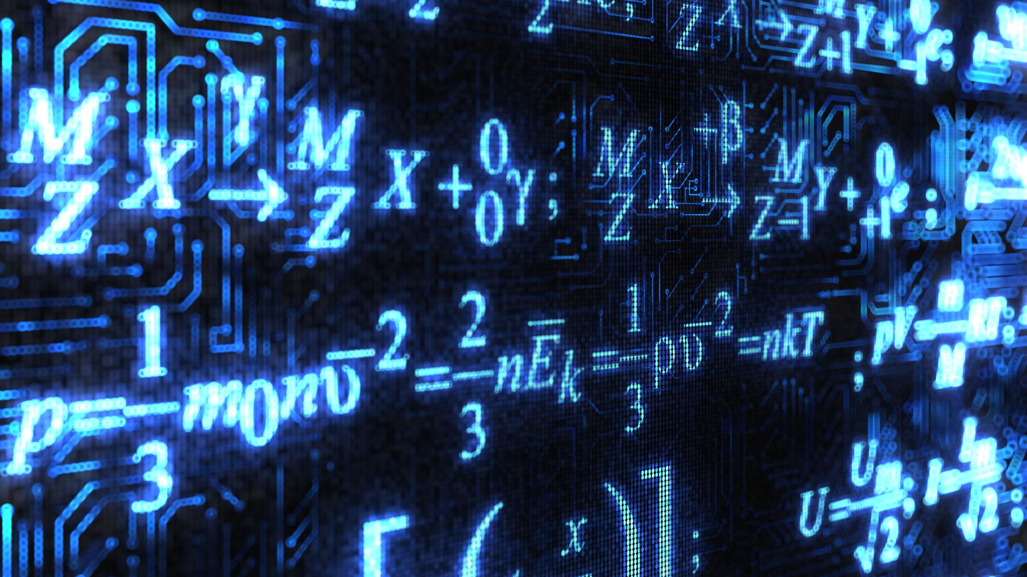
uses of calculus in physics
In physics, for example, calculus is used to help define, explain, and calculate motion, electricity, heat, light, harmonics, acoustics, astronomy, and dynamics.

Slide 22
uses of calculus in physics
Integration is very much needed. For example, to calculate the Centre of Mass, Centre of Gravity and Mass Moment of Inertia of a sports utility vehicle.
To calculate the velocity and trajectory of an object, predict the position of planets, and understand electromagnetism.

Slide 23
Presented by ahad ali khan

Slide 24
USES Of calculus in chemistry
The concepts of calculus is needed in Thermodynamics, chemical kinetics and Biochemistry, differential and linear algebra in quantum chemistry

Slide 25
USES Of calculus in chemistry
Thermodynamics : You need to have good skills in math to do thermodynamics, also in mass transfer or heat transfer, everything which is close to process chemistry, as per the McCabe Thiele model for distillation (for example) this is not hard but you need.
Quantum Chemistry : Here come the hardest thing (as I know it). You need to be very good in linear algebra, able to solve differential equations, have some skills in analysis to calculate integrals, and so on.
Kinetics : Calculus is not really hard but some times really weird. Also have some skills in algebra can help and be able to solve differential equations.

Slide 26
Presented by anique khadim

Slide 27
USES OF calculus in biology
Biologists use differential calculus to determine the exact rate of growth in a bacterial culture when different variables such as temperature and food source are changed.
The field of epidemiology — the study of the spread of infectious disease — relies heavily on calculus. It can be used to determine how far and fast a disease is spreading, where it may have originated from and how to best treat it.

Slide 29
conclusion
Calculus is used even in the most ordinary, every day things. The movies you loved as a child and the video games you play today are all programed with a significant amount of calculus and other math forms in order to achieve the most realistic image and life like movements.

Slide 30

any question ?

Slide 31
Thank you

